Slide 1

Biology 341 Molecular Genetics Sundays- Wednesdays 1-2
Jordan University of Science and Technology
Department of Biotec. And Genetic ENG.
First semester 2022/2023
Chapter 1
Dr. Osamah Batiha Ph1 L1 oybatiha@just.edu.jo
Notes:
add little bit on meiosis here at end of lect 1

Slide 2
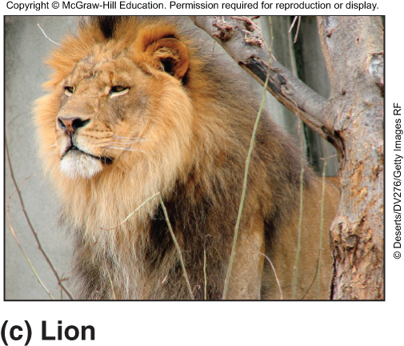
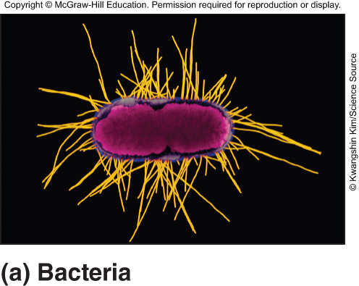
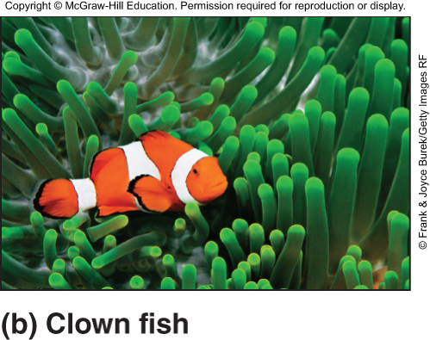
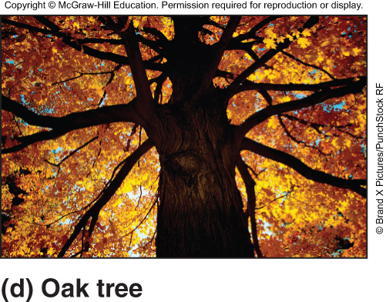
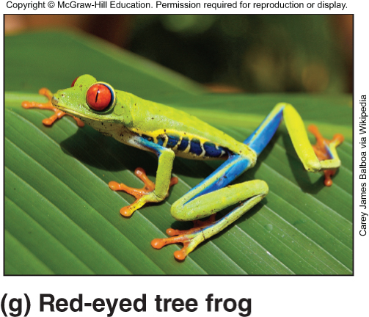
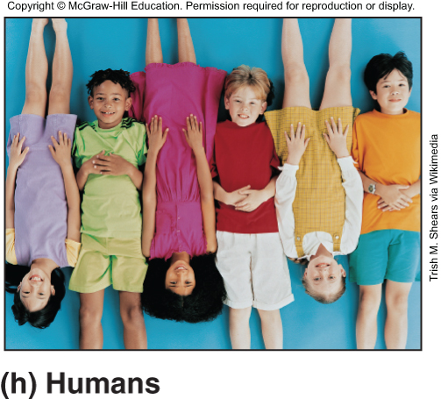
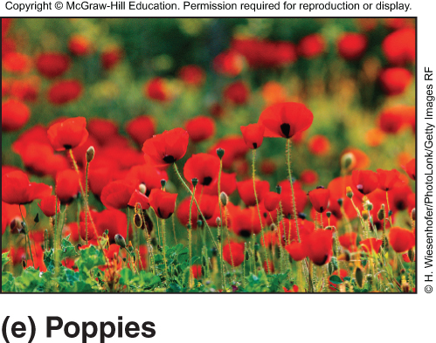
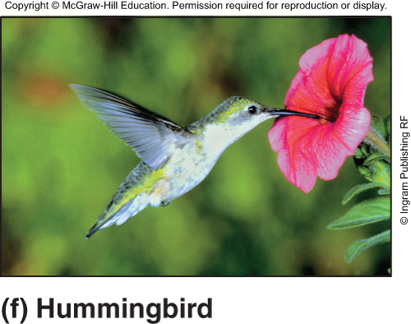
The biological information in DNA generates an enormous diversity of living organisms

Slide 3
Studying genetics
Living organisms are distinguished by their ability to reproduce their own kind
Genetics is the scientific study of heredity and variation
Heredity is the transmission of traits from one generation to the next
Variation is demonstrated by the differences in appearance that offspring show from parents and siblings
© 2011 Pearson Education, Inc.

Slide 4
Three milestones in genetics
Mendel – basic laws of inheritance – 1865
Watson and Crick – structure of DNA – 1953
Human Genome Project and Celera – sequence and annotation of human genome - 2003
Notes:
for the remainder of my class I’m going to summarize some of the key concepts that come up in my lectures
in the history of genetics there are lots of milestones – key discoveries events – if we had to choose 3 I’d pick these – mendel started the field
structure of dna in the 50s
human genome project 15 years ago.

Slide 5
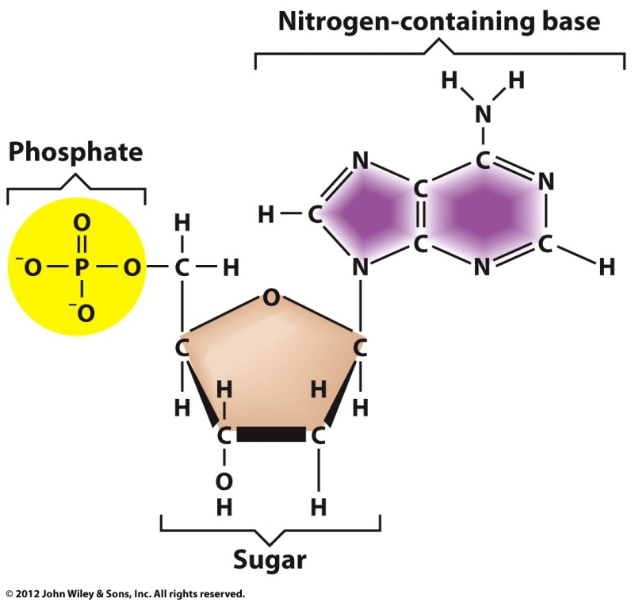
What is a Gene?
Genes are made of nucleic acids
Nucleic acids are made of building blocks called nucleotides
Nucleotides have three components
Sugar molecule (ribose or deoxyribose)
Phosphate molecule
Nitrogen-containing molecule (adenine, guanine, cytosine, thymine, uracil)
RNA is ribonucleic acid
DNA is deoxyribonucleic acid

Slide 6
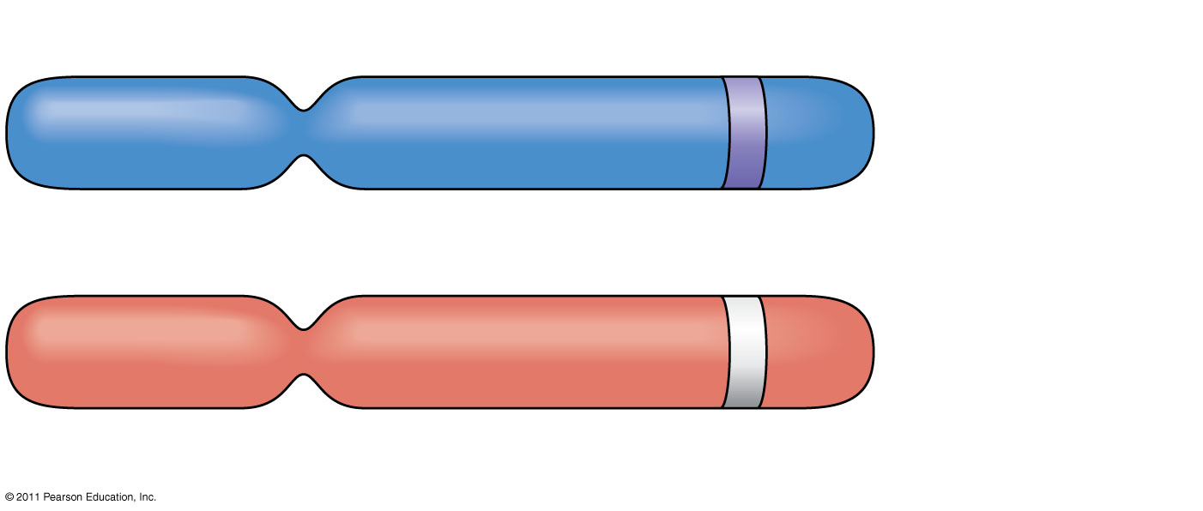
Allele for purple flowers
Pair of homologous chromosomes
Locus for flower-color gene
Allele for white flowers
Notes:
Figure 14.4 Alleles, alternative versions of a gene.

Slide 7
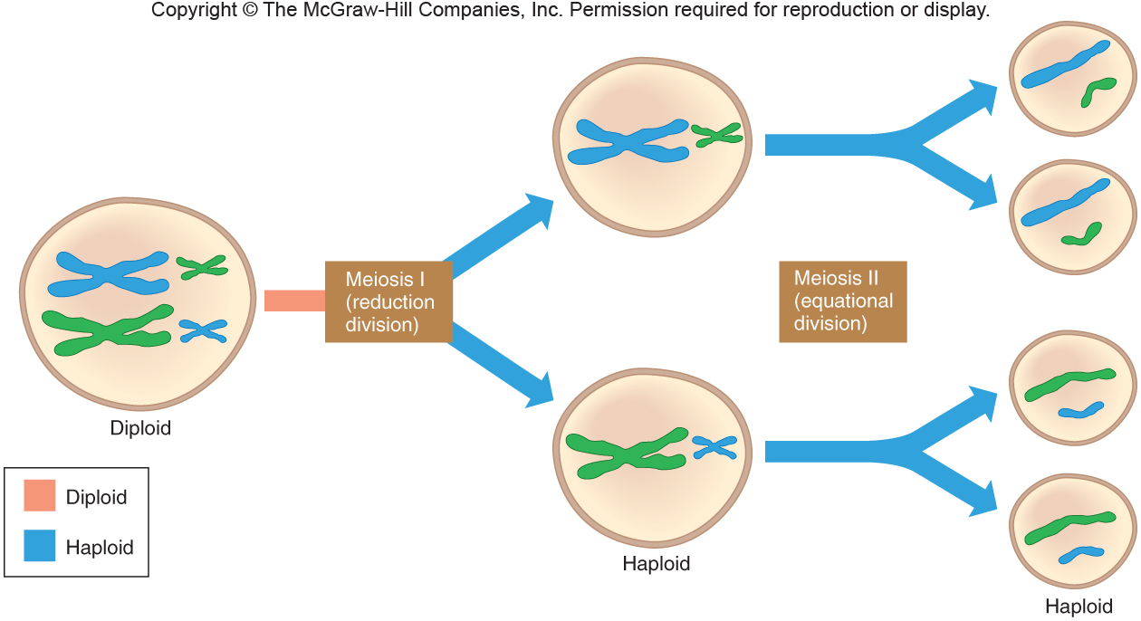
Meiosis
Figure 3.3
Notes:
7

Slide 8
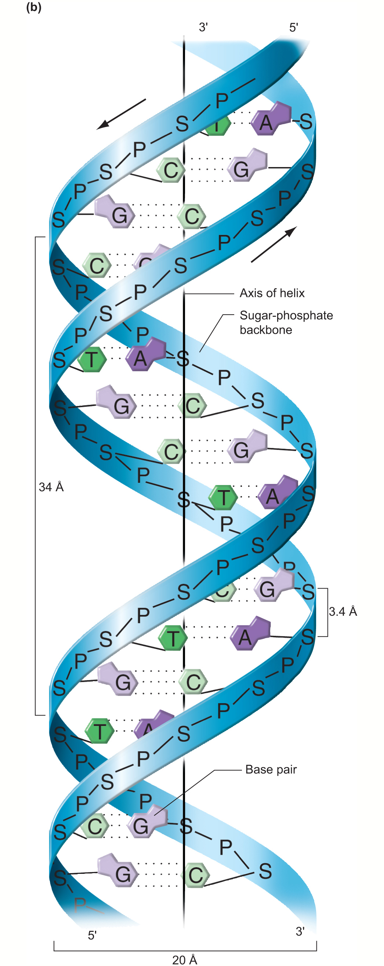
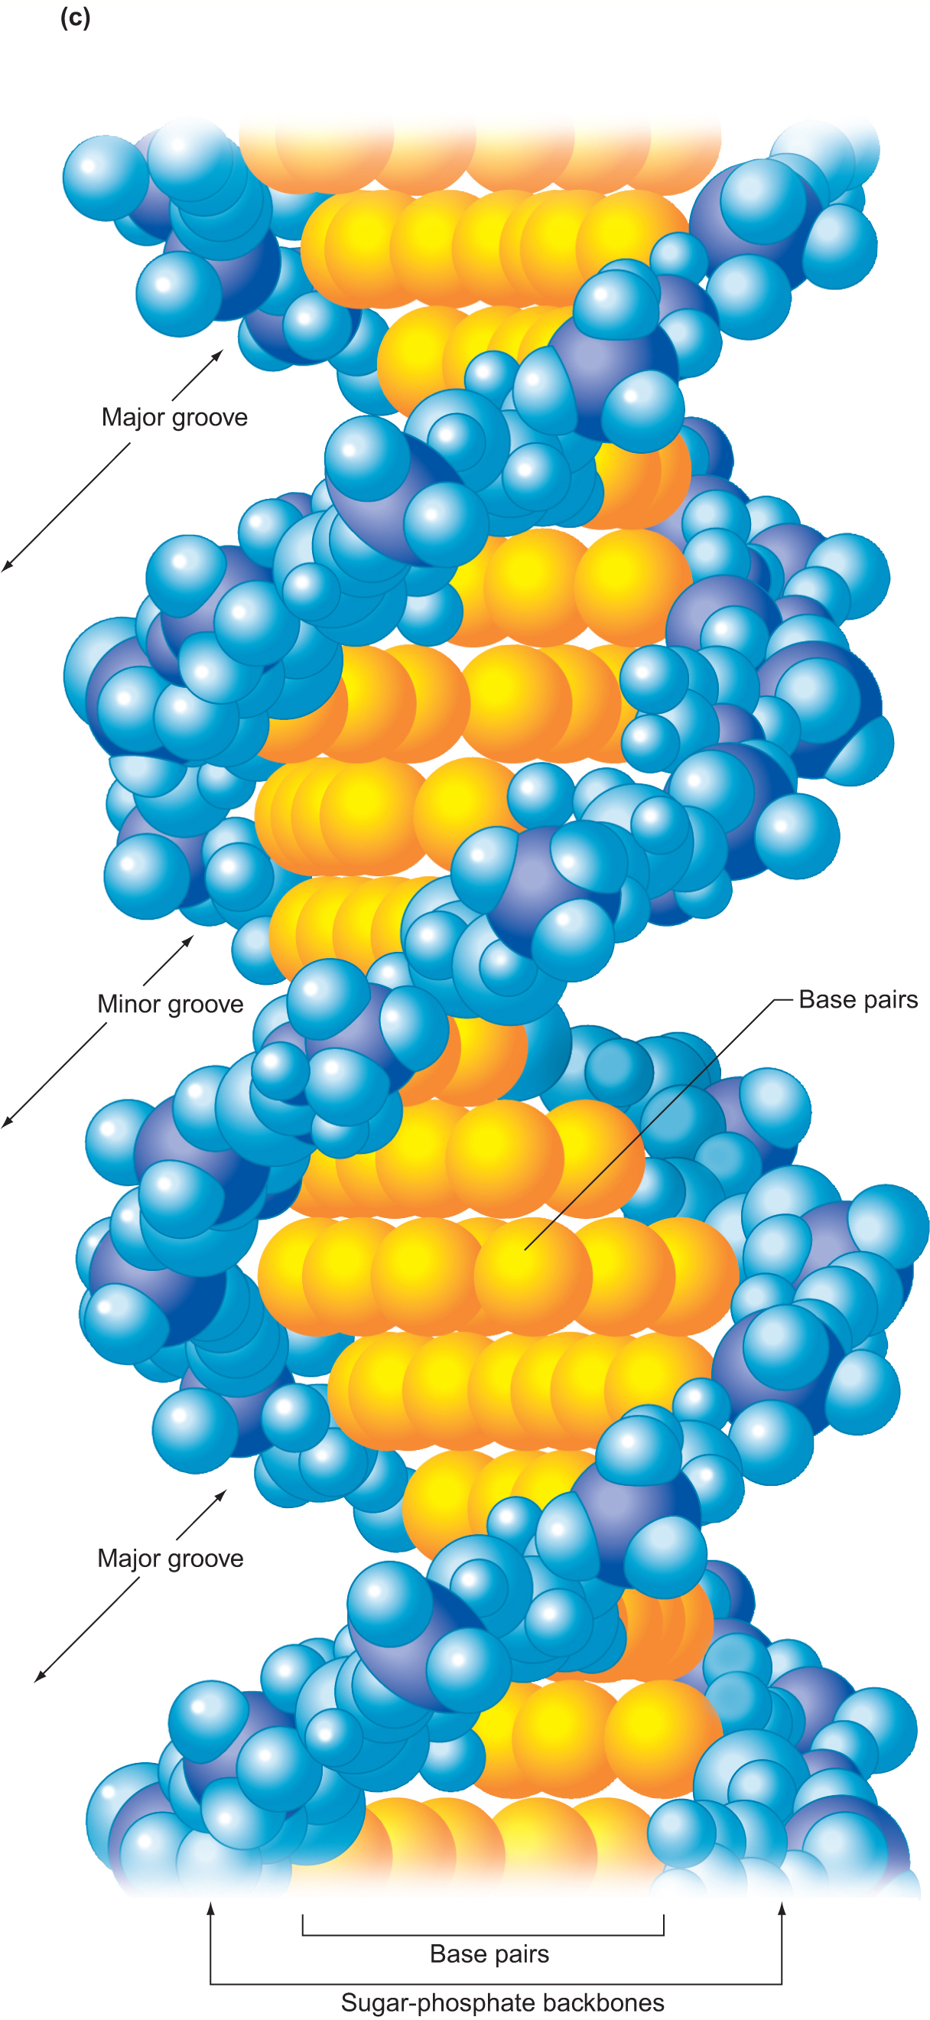
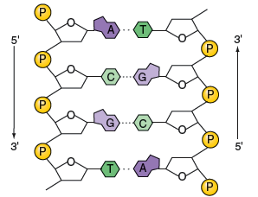
Feature Fig. 6.11
Notes:
for the remainder of our first class I want to introduce something that will come up a few times in this course – anyone know what this is? deoxyribonucleic acid. this comes up first in lecture 7 –
in the first 6 lectures we deal with genetics bc: before crick (and watson) – as we will see in lect 7 – this molecule is the basis for all genetics in all organisms. all life on earth uses dna – even viruses – even viruses that do not contain dna – they need to make dna at some point in their life cycle.
consists of a backbone of pphosphates and sugars. the sugars are attached to bases – one of 4 – adenine, guanine, thymine or cytosine
the bases from one strand interact with bases on the other strand – due to constraints c on one strand must pair with g on other, while a and t can pair.
the two strands are not identical but they are complementary – the base sequence on one can be used to predict the sequence on the other. and it can be used as a template to synthesize a copy of the other.

Slide 9
Two critical functions of DNA
Replication – necessary to ensure that genome is replicated each cell division and each generation - heredity
Code for proteins (and functional RNAs):
gene transcription → RNA
translation – nucleotide sequence of mRNA specifies amino acid sequence of a polypeptide.
transcription may also generate untranslated RNAs that have functions (eg. rRNA, tRNA, miRNA).

Slide 10
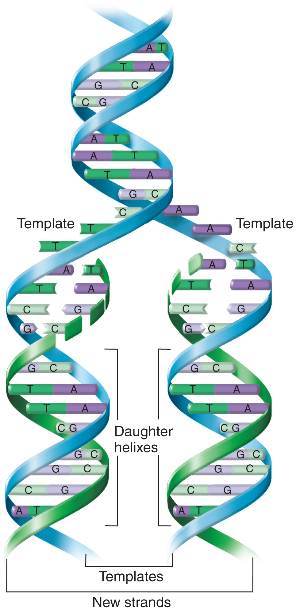
The model of DNA replication postulated by Watson and Crick
Fig. 6.16

Slide 11
Two critical functions of DNA
Replication – necessary to ensure that genome is replicated each cell division and each generation - heredity
Code for proteins (and functional RNAs):
gene transcription → RNA
translation – nucleotide sequence of mRNA specifies amino acid sequence of a polypeptide/protein.
transcription may also generate untranslated RNAs that have functions (eg. rRNA, tRNA, miRNA).
Notes:
so the 2nd critical function of dna is to make proteins

Slide 12
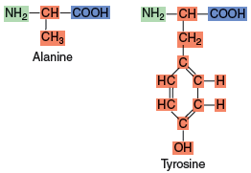
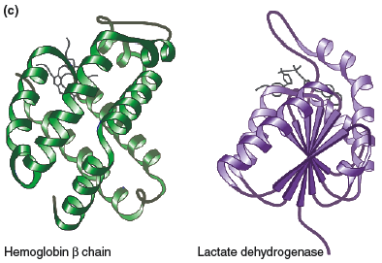
The amino acid sequence determines the three-dimensional shape of the protein
Chemical formulas for two amino acids
Three-dimensional shapes of two proteins
Figure 1.5a
Figure 1.5c
Notes:
proteins like DNA are made up of repeating units
there are 20 common amino acids – proteins are arrangements of these – here are two amino acids
if these were together on a protein they would be joined by a peptide bond – between this c and this n
proteins are chains of amino acids – they fold in large part based on their sequence, and have some activity.

Slide 13
Proteins
make up most of the mass of a cell
regulate all cellular processes directly or indirectly
enzymes involved in energy utilization, energy storage.
enzymes for biosynthesis or breakdown of other macromolecules (including DNA).
proteins form scaffolds to hold other proteins and macromolecules in place – to organize the cell.
proteins regulate transport into and out of cells and signaling between cells.
motor proteins and other proteins regulate intracellular transport.
Notes:
so while dna is critical to life – proteins are equally so – and one could argue that

Slide 14
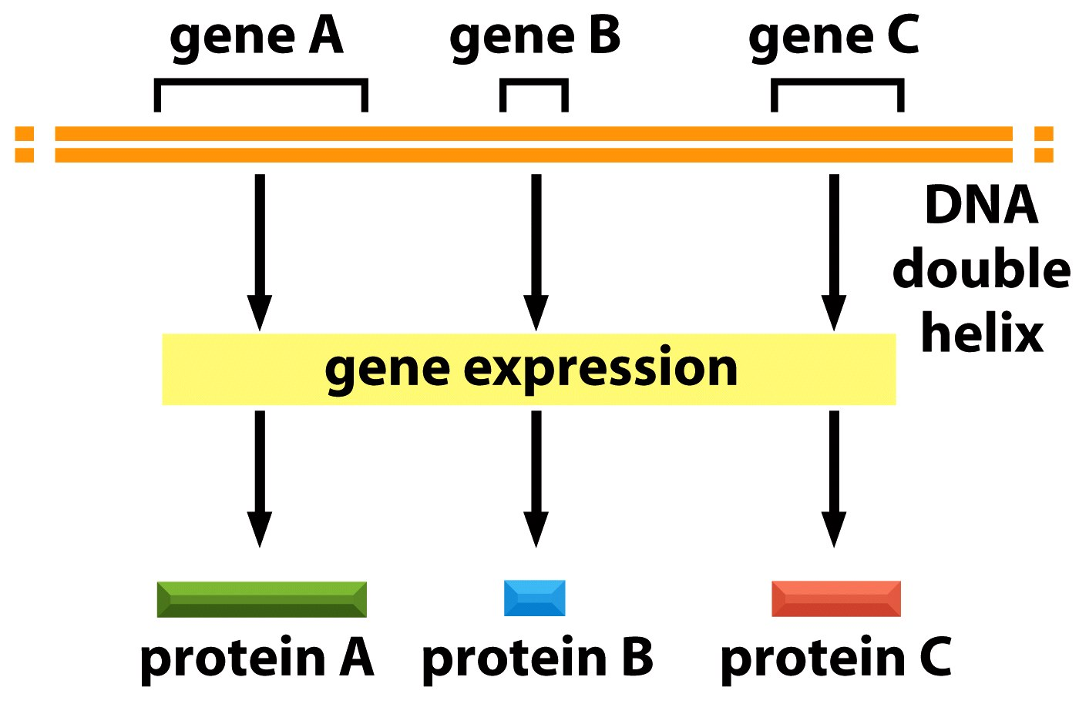
gene expression = transcription and translation
Figure 4-6 Molecular Biology of the Cell (© Garland Science 2008)
Notes:
so dna is necessary because it encodes proteins. the process of converting information in dna to proteins is gene expression – and the båsics of this will be taliked about in lectures10 and 11
to summarize now:
genes are sequences on the dna that will code for proteins

Slide 15
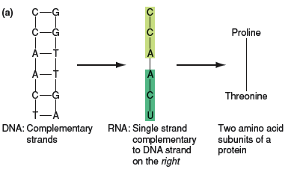
RNA evolved into an intermediary in conversion of DNA information into protein
single strand of RNA is made from DNA template
Bases are read as triplets to encode amino acid subunits of protein
Fig 1.7a
Notes:
the rna sequence dictates the sequence of amino acids of a polypeptide or protein

Slide 16
Mutations in genes result in altered proteins and give rise to different traits
wild type protein
G-C
G
Arginine
altered protein
Fig 1.7a

Slide 17
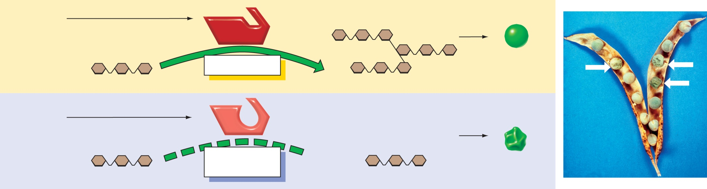
Mutations lead to different traits
Gene
Pea Shape
Dominant
allele
Active
enzyme
R
Conversion
Unbranched starch
Branched starch
Round pea
Recessive
allele
Inactive
enzyme
r
No
conversion
X
Unbranched starch
Unbranched starch
Wrinkled pea
(right): Reprinted from Bhattacharyya MK, et al. Cell. 1990 Jan 12: 60(1):115–22, with permission from Elsevier
Notes:
here’s an example from lect 2 – a gene callled R – makes a protein – an enzyme – this enzyeme makes branched starches. if the gene has a mutation it makes a protein with an altered amino acid sequence. This makes an inactive enzyme – the result for the pea plant is they cannot make branched starches. the result for us is that we have to eat wrinkly peas.

Slide 18
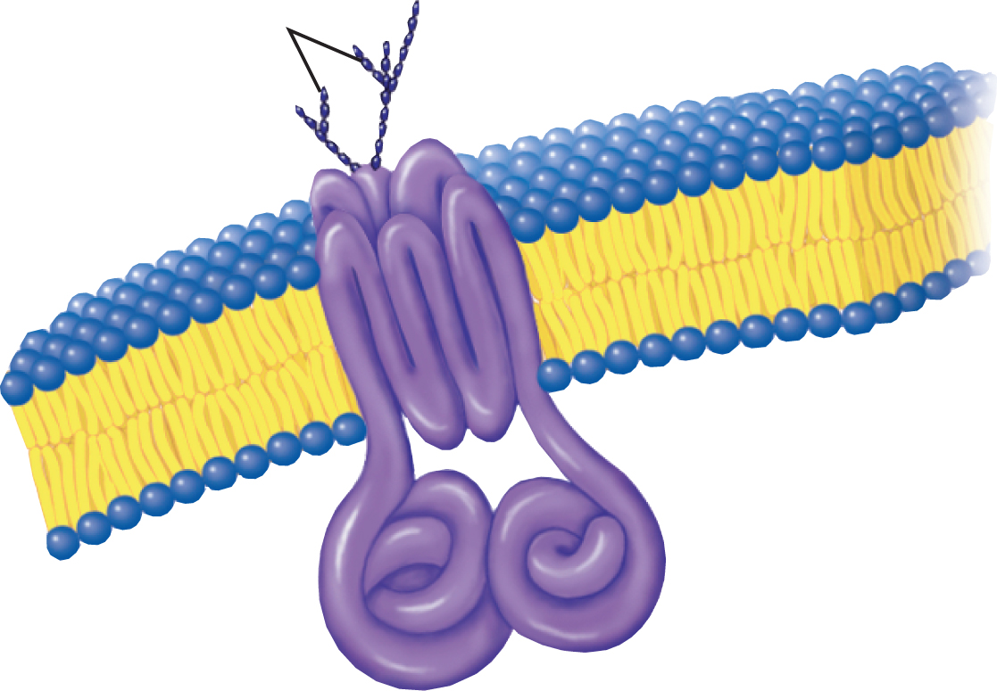
Mutations in the cftr gene lead to Cystic Fibrosis
Carbohydrate
Side chains
Lipid bilayer of
Cell membrane
CFTR protein
Copyright © The McGraw-Hill Companies, Inc. Permission required for reproduction or display.
Notes:
so mutations in genes lead to changes in proteins and this can lead to differences between individuals, including the case of disease.
here’ a gene that when mutated leads to alteration of the corresponding protein – cftr – it is a membrane channel that is used in most cells in your body to transport chloride ions
this channel is particularly immportant in cells of the lung – and that’s why cf affects lungs
so alterations in genes can cause disease

Slide 19
Three milestones in genetics
Mendel – basic laws of inheritance – 1865
Genes and the rules of inheritance
Watson and Crick – structure of DNA – 1953
Human Genome Project and Celera – sequence and annotation of human genome - 2003
Notes:
the next big milestone was not really a conceptual milestone – but definetly lead to a huge number of conceptual advances – which will be discussed in the 2nd half of the course.
the usefullness of genome sequence comes from the annotation – taking the raw sequence data and predicting with pretty good accuracy where the genes are and what the proteins are that are made
one thing that I’ll touch on for a minute that came out of the genome project – ability to compare humans to other organisms at the dna level or protein level

Slide 20
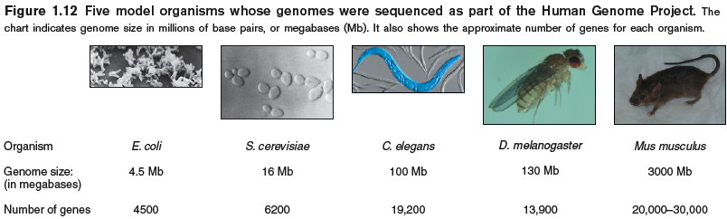
Genomes of five model organisms were sequenced as part of the Human Genome Project
25,000
Figure 1.12
Humans? 27,000
Zebrafish? 36,000
Notes:
along with the sequencing of the human genome several other animal genomes were sequenced – most before that. the mouse here is very similar to us – in terms of what genes we have and what proteins they make, we are more similar to mouse than different. as you go further away – divergence – but really it’s the similarities that are striking. when you look at the genome of some of these distantly related organisms they are remarkably similar

Slide 21
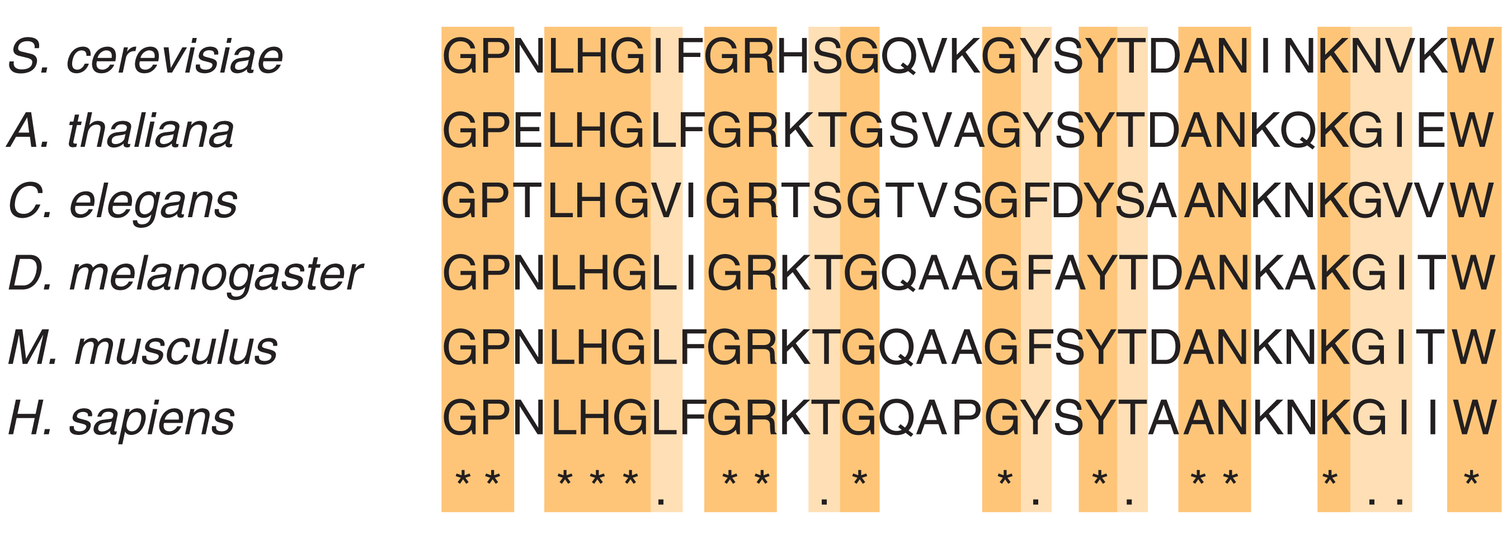
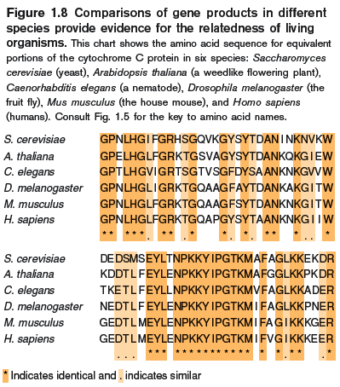
Many genes have similar functions in different organisms
Comparison of gene products in different organisms can reveal identical and similar amino acid sequences
e.g. cytochrome C protein from six species
Figure 1.8
Notes:
here is part of the sequence of the cytochrome c protein – a protein that is important for energy production in mitochondria. this is ours, here’s mouse – identical except for 3 amino acids. fruit fly- almost the same – here’s a single celled yeast – pretty far from us in evolution – again most amino acids are the same –
protein sequence is derived from dna – so if we looked at the dna sequence of this gene it would also be very similar.
why they evolved from a common ancestor and acquired a few mutation along the way.
one critical thing that we learn from this type of comparitive genomics is that what we learn in yeast is likely to also apply to humans. this validates the approach to genetics that has been used since Mendel – to study genes in model systems – plants or animals or bacteria or viruses that are simple and easy to work with – and making conclusions that are universal.

Slide 22
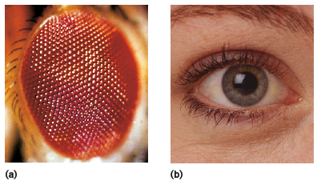
A gene from one organism can functionally replace a gene in another organism
Example: Pax6 gene is required for eye development in insects, mice, and humans
Expression of human Pax6 gene in Drosophila can induce eye development
Figure 1.9
Notes:
the pax6 gene is required for eye formation in flies and in humans. you can take the human version of the gene and put it into flies and make it express in the legg to make an eye – most likely it would work the other way – the fly gene would work in the human.
an important point to be made here – and I’ll end here – is that genetics can be studied in any organism and the insights we gain from studies in fruit flies or viruses can help us to understand human genetics as well.

Slide 23
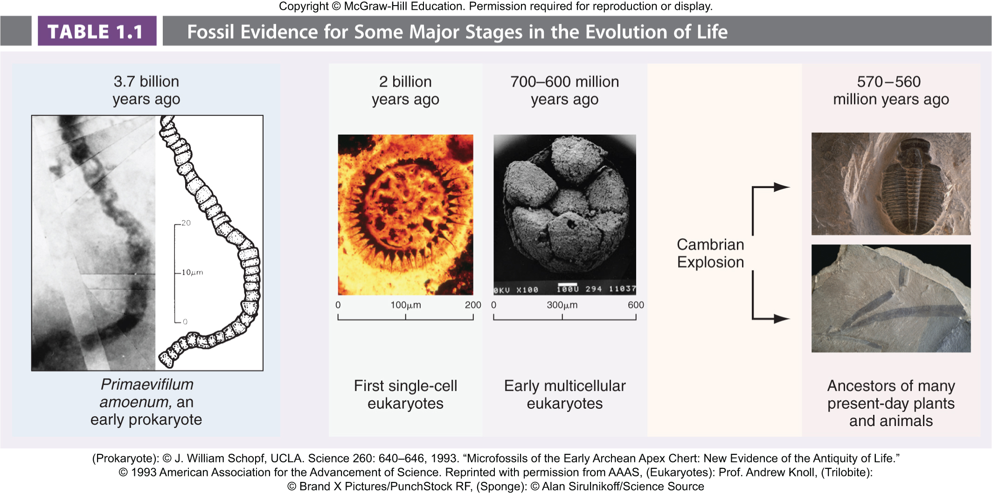
Could Genetics explain Evolution?
How did evolution result in the amazing diversity of life-forms over time?
Notes:
How did evolution result in the amazing diversity of life-forms over time?
-Exons are arranged into genes, genes duplicate and diverge to form gene families and superfamilies…
- Another way is by controlling the spatial and temporal regulation of gene expression.

Slide 24
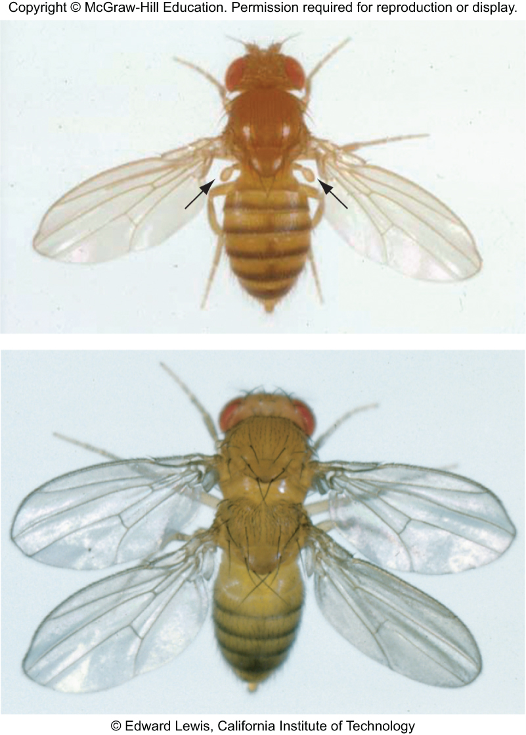
Mutation of key regulatory networks is important for evolution of complexity
Regulatory networks affect the location, timing, and level of expression of genes.
Example of a dramatic change caused by mutation of a regulatory network:
In nature, two-winged flies evolved from four-winged flies by converting wings to halteres.
In the lab, a two-winged fly was reverted to a four-winged fly by changing one element of a key regulatory network.
haltere

